Slide 1
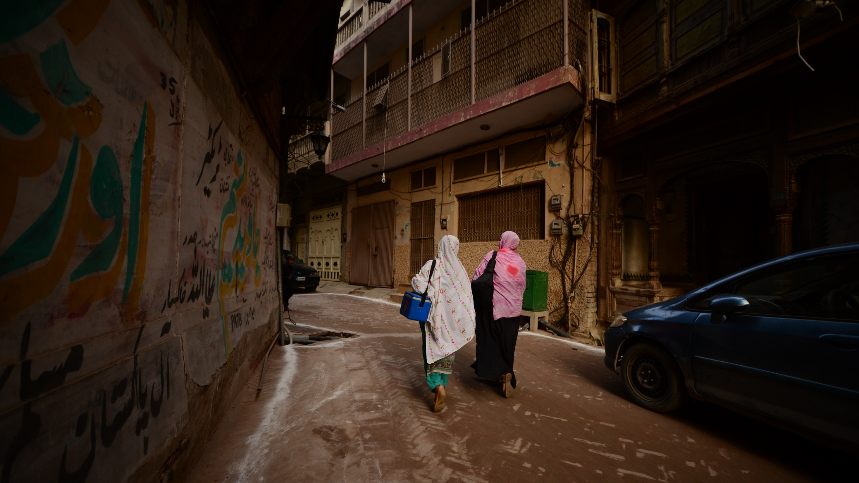
Technical Advisory Group on Polio Eradication in Pakistan
Feedback from TAG
29-30 August, 2019
Photo Credit: Mobeen Ansari

Slide 2
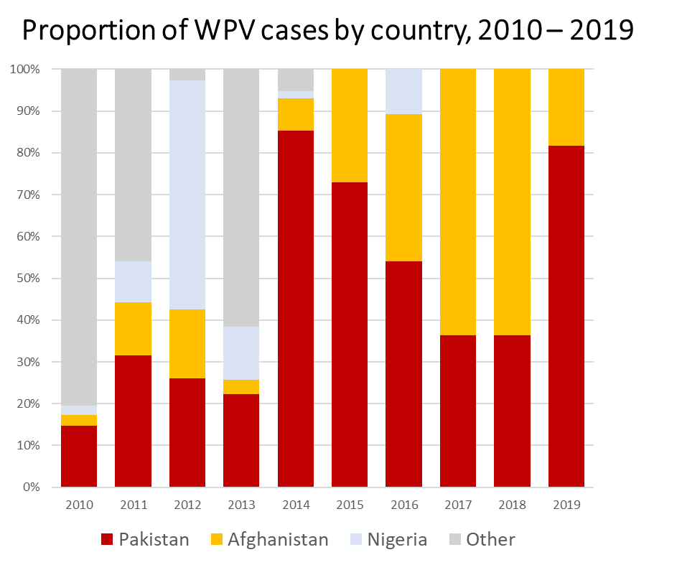
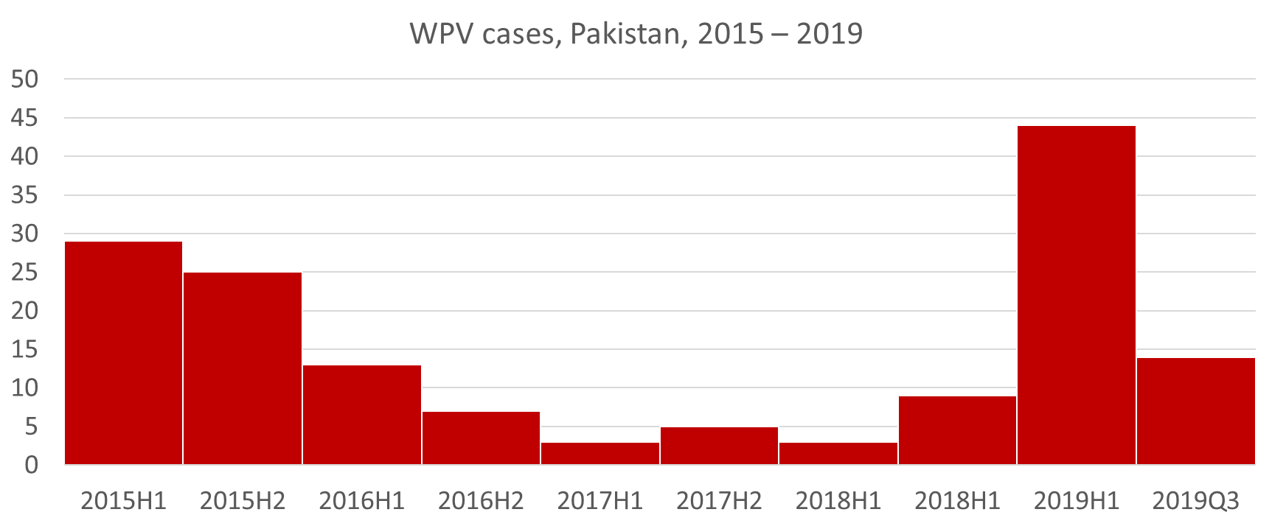
Pakistan program is on a failing trajectory, putting the rest of the global program at risk
Pakistan program is at a critical juncture – the costs of failure would be enormous.
80% of global WPV1 cases
Nigeria announced 3 years without polio.
Risk of exportation could jeopardize the global landscape
How is the program failing?
Failure of coherent vision and unified strategy (“One Team”)
Failure of national-provincial-district-UC management
Failure of focus on effective, high-quality program activities
Failure to build trust with communities
There is a huge window of opportunity to fix this with political commitment:
PM, CM, Army Support
Assessments / reviews
Commitment to change/ reset

Slide 3
Need for Transformation Putting the program back on-track
The program needs to transform itself
Super High-Risk UC focus (SHRUCs) – focus on quality SIAs combining integrated operational and communication activities
District, Provincial and National EOC management and support
Process: e.g. improving microplanning
Data: streamlining data volume and ensuring program use value
Transformation
Enough information now to begin roll-out in Sindh, with support from provincial/national level
Subsequent roll-out in KP and Quetta Block as review process is completed
One Team
Community: focus on building community trust
People: clarifying key roles and responsibilities
People: training and capabilities
Notes:
- QB? Change?

Slide 4
Major risks to the program
Failure to shut down transmission in specific UCs of Peshawar and Karachi will maintain the cycle of continued transmission and periodic outbreaks
Large portions of Afghanistan have been inaccessible to vaccination teams since April 2019, leaving a large population of children vulnerable to cross-border WPV1 transmission
Deep entrenchment at implementation and management level with resistance to change
Cautiously optimistic that Bhurban meeting could be a good first step to get the leadership of EOCs aligned
Poor quality SIAs and failure of regular, strategic engagement at community level to build trust resulting in increasingly frequent rounds and growing community frustration, undermining the long-term viability of the house-to-house strategy
Inappropriate association of PEI with other services risks making the program more vulnerable to bargaining and negotiations
Notes:
bargaining chip, with EPI, WASH, nutrition, careful when we define rank order lists of priority Ucs based on epidemiology and program performance because adjacent Ucs 1) neighbors wonder why not getting that level of service 2) community connectivity that has to be included, if many intricately linked then need to do context specific interventions
Integration? Delivery? Alignment?

Slide 5
Challenges
Lack of focus on core implementation strategies has resulted in the program rapidly sliding backward as demonstrated by widespread transmission
Lack of implementation of & progress against previous TAG recommendations
The program is faced with a lot of ideas to address challenges. Lack of consensus on the most urgent changes which need to be made in the program (i.e., management, strategic changes at each level) and how to best build on the high-level commitment of the Prime Minister, Chief Ministers, and leveraging the full support of the Pakistan Army
Program has become increasingly complex with addition of multiple new strategies and initiatives – need to go back to basics, focusing on simplified approach
Lack of prioritization to achieve clear strategic approach ensuring laser-focus on Super High Risk UCs, stopping outbreaks, and improving program quality in other areas
Notes:
Too many

Slide 6
TAG Summary Recommendations
Back to Basics…
Capitalize on current country leadership and regain One Team approach at all levels
Ensure implementation of Transformation as a matter of urgency, with laser focus on SHRUCs
Concentrate on building community trust as a program priority
Ensure high-quality SIAs in order to achieve a program which can interrupt transmission
These are the core elements of a viable program

Slide 7
Leadership Engagement
Observations
Encouraged by the strong and vocal support from Prime Minister, Chief of Army Staff, and Minister of Health
Acknowledge the strong program leadership by Minister of Health, PMFP, & NEOC Coordinator and continued support of GPEI
Recommendations
Fully take advantage of personal leadership of Prime Minister, Minister of Health, Provincial Chief Ministers, and Army leadership
Regular review by National Task Force and Pakistan Army Leadership (every 3-6 months)
Work with the Pakistan Army in a sustainable and context-specific way
Ensure ownership by the highest leadership of specific roles & responsibilities of the administration and Pakistan Army in the Super High Risk UCs (SHRUCs)

Slide 8
Transformation
Based on epidemiology of polio in persistent core reservoirs, and outcomes of programme and management reviews, there is an urgent for programme transformation

Slide 9
Transformation – revitalize management
Make the overall program fit-for-purpose
Focused transformation, starting with the super high-risk UC level
Focus on quality SIAs simplifying and combining integrated operational and communication activities,
People: clarifying key roles and responsibilities, training and capabilities
Process: improving microplanning
Data: streamlining data volume and ensuring program use value

Slide 10
Transformation – focus
Re-focus program on basic priorities
Community: focus on building community trust
High-quality SIAs
Strengthen routine immunization service delivery
Delivery of additional services e.g. Ehsaas, BISP, health, nutrition, WASH

Slide 11
Delivering transformation
National and provincial EOCs
NEOC and PEOCs to form transformation task teams under the leadership of their respective EOC Coordinators with inputs from management experts
Develop a clear joint workplan and commence implementation
Integrate the plan and key deliverables into the NEAP 2019/2020

Slide 12
One Team PEI Command and Control in disarray
Observations
Polio Eradication has only ever succeeded under the One Team approach
Currently, there is no unified PEI command and control
Cascade impact on the coherence of provincial and sub-provincial levels
Disharmony between NEOC and KP EOC is creating a state of crisis, impacting the program’s ability to control the outbreak in Southern KP and focus on the SHRUCs of Peshawar
Recommendations
Use the upcoming Bhurban retreat to revise “Modus Operandi” within and between EOCs, promote team-build and emphasize a healthy working environment with clear roles and responsibilities
Take advantage of planned management reviews of Provincial and National EOCs as soon as possible
In the long-term, to continue promotion of the one-team approach, conduct periodic management reviews and assessments of organizational health
With the one-team approach in mind, also enact province-specific interventions – see upcoming slides

Slide 13
NEAP 2019/2020 Requires revisions, must refocus and simplify programme
Observations
Current version of the NEAP is not fit-for-purpose
Recommendations
Go back to drawing board in next months
Align the NEAP with TAG recommendations, ensuring clear definition and focus on SHRUCs
Overall shift to transformation – data, process, management at each level
Notes:
Recommendation too similar to the next one?
The “Pause” must come with some gain

Slide 14
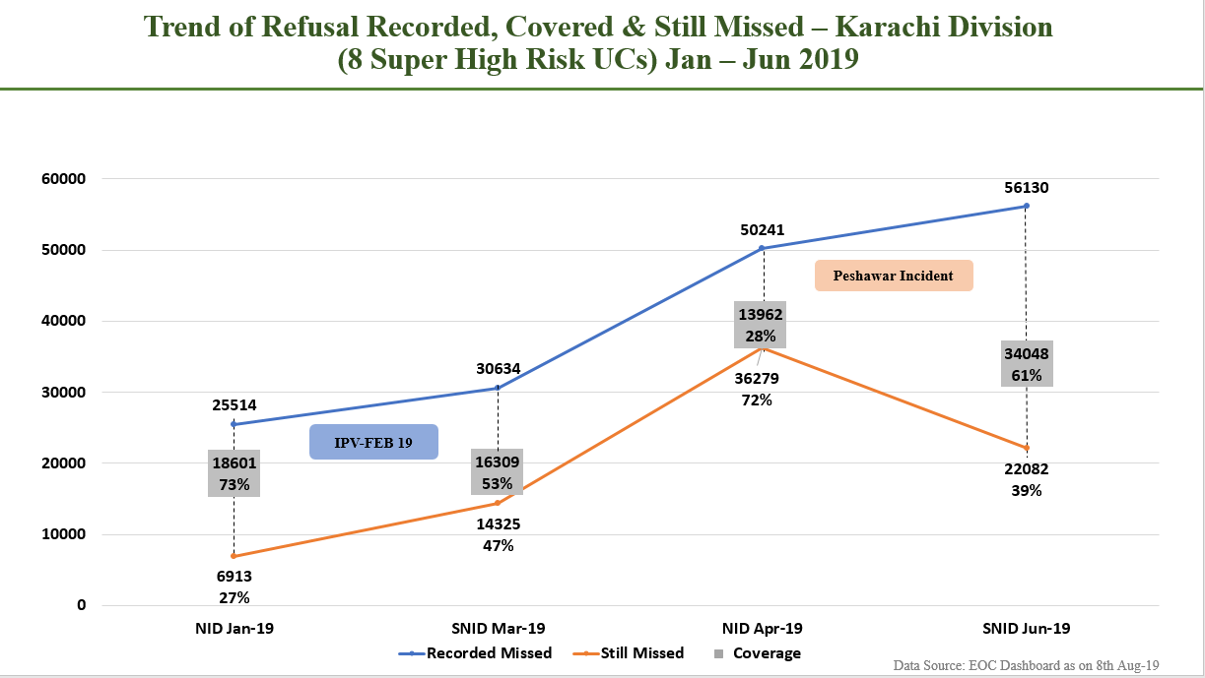
SIAs – current challenges
Improving quality of SIAs is an overarching priority
Deteriorating SIA quality even before the ‘Peshawar Incident’
Continued frequent poor quality SIAs leading to community resentment and not to interrupting transmission
Attock
Rawalpindi
Mianwali
Chakwal
Jhelum
Gujrat
Khushab
Mbdin
Sialkot
Narowal
Sargodha
Hafizabad
Gujranwala
Bhakkar
Chiniot
Sheikhupora
Nankanasahib
Jhang
Faisalabad
Lahore
Layyah
TTSingh
Kasur
Muzaffargarh
Sahiwal
Okara
DGKhan
Khanewal
Pakpatan
Multan
Vehari
≥ 90%
Lodhran
Bahawalnagar
Rajanpur
Jan NID
%LQAS lots passed
< 90%
Bahawalpur
RYKhan

Slide 15
SIAs - objectives
Strategic Objectives of SIAs through June 2020
Establish capacity for high quality SIAs in super high risk UCs (SHRUCs) of Karachi, Peshawar, Quetta, Killa Abdullah, and Pishin
Stop outbreaks in South KP, Torgham, Hyderabad, Lahore, and Rawalpindi and effectively respond to any newly infected districts
Maintain overall population immunity to mitigate the risk of further WPV spread
The SIA recommendations aim to give the program space to reset to get it back on track to finally interrupt WPV transmission
It is imperative that this space is used to successfully reset!

Slide 16
SIAs
Objective 1 – Establish capacity for high quality SIAs in super high risk UCs
Take an immediate 3-month pause from SIAs in these areas to begin systematic implementation of critical transformative changes.
Ensure dedicated teams and effective management infrastructure at NEOC, PEOCs, and DPCRs to implement transformative changes in the SHRUCs
Ensure sufficient spacing between SIAs in SHRUCs – at least 8 weeks between end of one SIA and the beginning of the next - to ensure transformative changes are implemented, fine tuned and sustained
Allow space to re-engage communities, improve essential immunization services

Slide 17
SIAs
Objective 2 – Stopping Outbreaks
In current outbreak areas of South KP, Hyderabad, Lahore, Torgham, Rawalpindi:
Stop all case response for 2-month pause to comprehensively address gaps in SIA quality, including community engagement and support to front-line workers
Next outbreak response SIA should be a sub-national campaign in November in the currently outbreak affected areas
For any new outbreaks in polio-free areas (tier 4):
Implement immediate outbreak response SIAs covering at least 2 million children starting within 2 weeks of detection
Continue SIAs of improving quality every 4 weeks until three SIA rounds are implemented after the last WPV case detection in the outbreak district

Slide 18
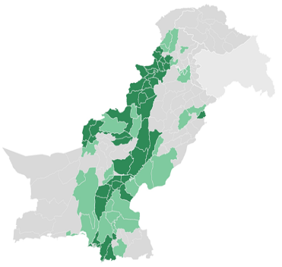
Proposed SIAs for NEAP 2019/20
Full district
Part of district
Not included
Dec 16, NID,
100%
Feb 17, NID,
100%
Apr 20*, NID,
100%
Jun 22
SNID, 50%
SIA objectives 1 and 3
Disputed territory
Disputed territory
Disputed territory
Disputed territory
3 month pause
8 weeks
8 weeks
8 weeks
Typhoid SIA
Sindh
Sept
Oct
Nov
Dec
Jan
Feb
Mar
Apr
May
June
2020
Jul – Dec 2020 (indicative):
Aug 17: SNID 50%
Oct 19: SNID 50%
Dec 21: NID 100%

Slide 19
Proposed SIAs for NEAP 2019/20
Full district
Part of district
Not included
SIA objectives 1 and 3
Dec 16, NID,
100%
Feb 17, NID,
100%
Apr 20*, NID,
100%
Jun 22
SNID, 50%
Disputed territory
Disputed territory
Disputed territory
Disputed territory
Typhoid SIA
Sindh
Sept
Oct
Nov
Dec
Jan
Feb
Mar
Apr
May
June
2020
SIA objective 2
Existing outbreak areas:
Outbreak response SIAs
(Hyderabad to plan around typhoid SIA)
Any new WPV case or env+ in tier 4: see outbreak response recommendations

Slide 20
Impact of Pakistan campaign schedule on global vaccine supply
Observations
The programme is engaged in multiple communication and social mobilisation activities, but without a sufficiently clear and coherent strategic direction
Observation: the programme has made good progress in developing social media strategies for managing negative influence and responding to crises
Recommendations
Critical need to expand the supplier base to Pakistan, including through licensure of products from suppliers new to Pakistan, for example licensure of a prequalified Chinese vaccine currently under review by DRAP
Ensure sufficient IPV funding as strengthening of EPI program

Slide 21
Communication – strategy
Observations
The programme is engaged in multiple communications and social mobilization activities, but without a sufficiently clear and coherent strategic direction
The programme has made good progress in developing social media strategies for managing negative influence and responding to crises
Recommendations
Community engagement using structured, evaluable approaches adapted for local context should be given priority, ensuring integrated management of all relevant CE actors (CBV, ComNet, RSP etc)
Social media strategy should continue to monitor and manage online content to support positive public messaging
Mass media strategy should focus on enhancing public confidence in PEI and OPV
Development of ‘perception management’ interventions should be done carefully, ensuring review of initiatives by a group of communication and media experts, monitoring content and impact and advising on adjustments
All communication activities should be executed with coherence ensuring consistency of content and messaging across all platforms

Slide 22
Communication: CBV
Observations
CBV has expanded to a level at which management and effectiveness may be compromised. CBV activity has been shifted to vaccination and operational support to the detriment of community engagement at a time when building community trust is critical
Recommendations
Following the Transformation recommendations, CBV in SHRUCs should be re-oriented to increase support systematic community engagement with clear management and reporting at UC level to create an enabling environment for high quality SIAs
Outside SHRUCs, CBV may be rationalised based on an assessment of community and operational needs in those areas

Slide 23
Synergy Between PEI and EPI
Observations
TAG welcomes Minister’s leadership in insisting on joint participation of PEI and EPI in all meetings
TAG welcomes EPI proposal for focused improvement in polio high risk districts supported by Gavi
TAG appreciates data on zero dose children and notes lack of clarity on process for covering these
Recommendations
Develop EI improvement plans for super high risk UCs and implement as soon as possible (using Gavi funding)
Clarify SOP and responsibilities for responding to zero dose
Deepen PEI-EPI collaboration on training, denominators microplanning, and monitoring
Ensure that IPV coverage is monitored at all levels and achieves the same figures as DTP3

Slide 24
Synergy Between PEI and Integrated Services
Observations
Integrated service delivery could provide an opportunity for community engagement and creation of an enabling environment for high-quality SIAs in the SHRUCs
But vaccination and PEI should not be allowed to become a transactional process, used as a bargaining chip
Recommendations
Identify areas with most marginalized communities (e.g. SHRUCs) and advocate through existing health and development policy/programmatic forums (e.g. EHSAAS) for accelerated multi-sectoral community development supporting convergence of key health and development programs
Ensure high level national and provincial policy umbrella to converge key health and development programs
Monitor progress of other partners and integrated services activities in core programme and assess the impact of such interventions on community attitudes to/acceptance of PEI

Slide 25
Khyber Pakhtunkhwa Programme has shifted from being an example to a crisis
Observations
Concerning region which remains a major global barrier to polio eradication
KP EOC is not aligned with the National EOC, roles and responsbilities unclear
KP FATA merger caused field uncertainty
Long standing hidden quality issues identified by KP EOC with this major outbreak
Fake FM and markers being sold in the community
Communication efforts were limited to only during the campaign with little follow-up – “not fit for purpose”
Response to cases was a reaction instead of proactively intervening on risk districts
Highlights the need for independent international monitors
Recommendations
Complete program reset necessary defining roles and responsibilities
Implement January 2019 TAG recommendations urgently
Two simultaneous but different strategic approaches with distinct action plans– 1) SHRUCs and, 2) outbreak response
Community engagement with a strategic approach
Outbreak analysis and coherent response strategies needed to clarify the way forward
*Q1 2015-Q3 2019. incl. erstwhile FATA

Slide 26
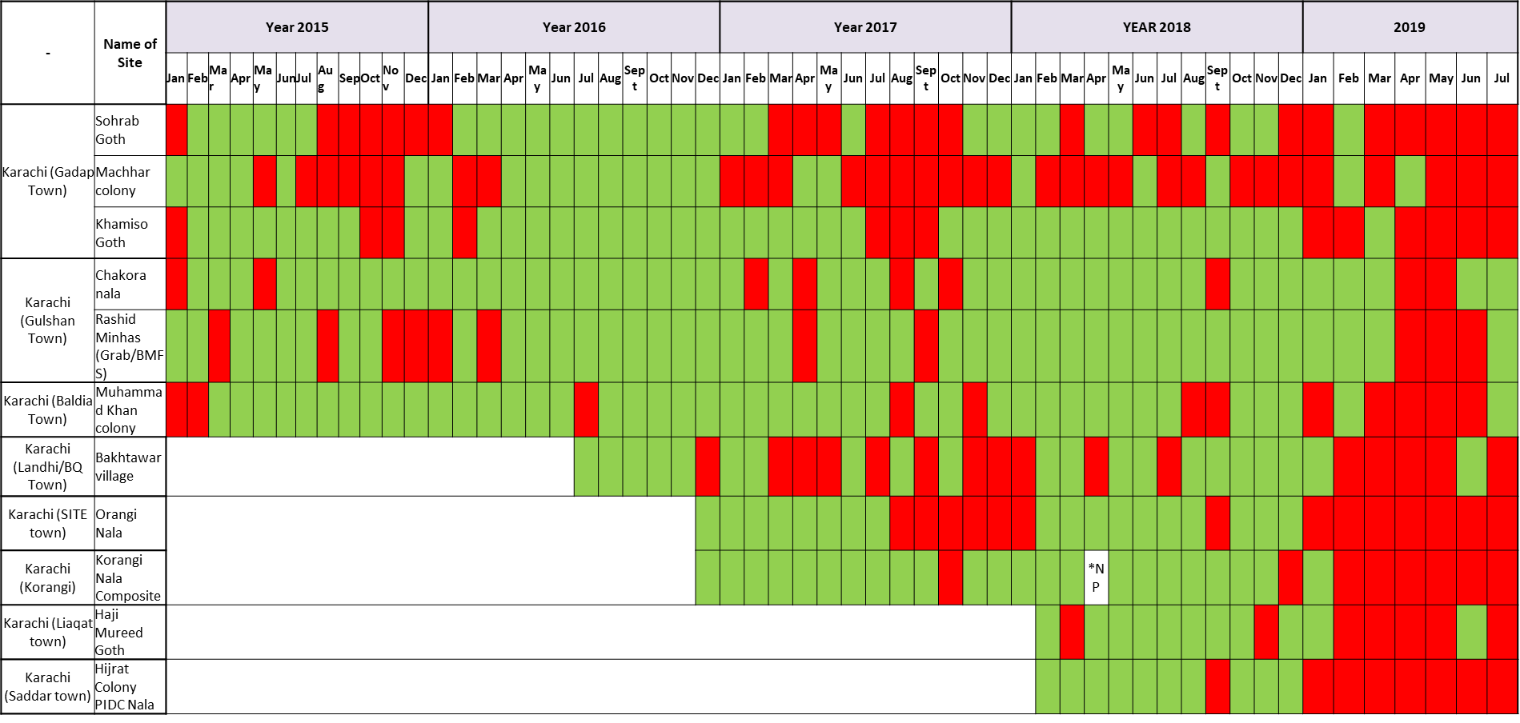
Sindh Transmission in Karachi now everywhere, Hyderabad back to bad old days
Observations
Appreciates the sustained leadership and oversight of Chief Minister and Honourable Health Minister but is concerned that action points and decisions taken go unimplemented
Uninterrupted transmission since 2017 in Gadap and now in 2019 almost all Environmental Sites in Karachi are positive, spillover to other parts of Sindh
Increasing trends of missed children and refusals stemming from community misconception of vaccine safety
The program has reached a ceiling level, as EPI coverages are low for the last seven years
Despite engagement of commissioner and other mgmt. oversight, issues are not resolved
Recommendations
Implement the January 2019 TAG recommendations urgently
Results of McKinsey management review need to be taken discussed and implemented at Provincial level as soon as possible
Develop a specific communication strategy specific to the Pashtun population
Develop a rank order tier UC classification list and plan for mapping tiers to specific interventions

Slide 27
Punjab Signs of deterioration everywhere, SIA quality worsening, outbreak not controlled in time
Observations
Jan NID
%LQAS lots passed
TAG appreciates the recent engagement of Chief Minister and Health Minister as well as appointment of the Provincial EOC Coordinator
Operational gaps are not being addressed as evidenced by continued failed LQAS lots
Number of still missed children in Rawalpindi and Lahore remains the same
Failed lots province-wide following January NID
20% missed children from population that are at risk; 25-29% no team, refusal 2-5 % indicates that the team is not vaccinating
HRMP is the main challenge for Punjab but has not been tackled in a systematic way
Attock
Rawalpindi
Mianwali
Chakwal
Jhelum
Gujrat
Khushab
Mbdin
Sialkot
Narowal
Sargodha
Hafizabad
Gujranwala
Bhakkar
Chiniot
Sheikhupora
Nankanasahib
Jhang
Faisalabad
Lahore
Layyah
TTSingh
Kasur
Muzaffargarh
Sahiwal
Okara
DGKhan
Khanewal
Pakpatan
Multan
Vehari
Lodhran
Bahawalnagar
Rajanpur
Bahawalpur
Recommendations
RYKhan
Focus on quality of operation in known weak areas
Need to focus on HRMP issues – specific communication, proactive community engagement
Ensure lessons learned in the synergy are implemented in 2019
≥ 90%
< 90%

Slide 28
Balochistan Success in Balochistan largely depends on success in Killa Abdullah
Observations
TAG appreciates the One Team approach at EOC and active engagement of Chief Minister
Problem is well-defined and can act quickly compared to other provinces
Decline in performance in Killa Abdullah has not been addressed yet despite the previous TAG recommendation
Recognition that frontline workers have been demoralized by Peshawar incident, killings, and harassment
Not much improvement in RI, despite recommendations from last TAG
5 million children not vaccinated in South Afghanistan
Recommendations
January TAG recommendations must be implemented urgently
Take immediate advantage of support from Pakistan Army at Friendship Gate and Killa Abdulla UCs
Build capacity of district- and tehsil-level control rooms
Develop a cohesive communication strategy (CBV, RSP, influencers, etc.)

Slide 29
Questions to the TAG - NEOC
Transmission is largely driven by a group of super high-risk UCs in core reservoirs. While the program already includes prioritization (e.g. tiering), there is no laser focus on the super high-risk UCs. Should the program develop a special approach including strategy/structure/HR/oversight/monitoring/etc. for these super high-risk UCs to focus on these persistently problematic areas?
While the CBV approach improved performance is many areas, CBV currently is too large to manage optimally and includes inappropriate areas. Does the TAG agree that the program should reduce the footprint of CBV to allow for improved management and focus in the super high-risk UCs?
Currently, the program’s tiering system leads to blanket interventions that are not always geographically appropriate (e.g. posh areas in Karachi are Tier 1). Does the TAG agree to re-vamping the tiering approach to ensure appropriate targeting and focus and its impact on interventions and mode of delivery (e.g. CBV vs SMT vs MT)?
Does the TAG endorse the proposed SIA Calendar (including the use of IPV) until June 2020?
Does the TAG agree with the need for the polio program to develop a mechanism for monitoring the implementation of integrated services in the super high-risk UCs?
Notes:
NUMBER USING INITIAL LIST

Slide 30
TAG Response to NEOC Questions
Should the program develop a special approach including strategy/structure/HR/oversight/monitoring/etc. for these super high-risk UCs to focus on these persistently problematic areas?
Does the TAG agree that the program should reduce the footprint of CBV to allow for improved management and focus in the super high-risk UCs?
Does the TAG agree to re-vamping the tiering approach to ensure appropriate targeting and focus and its impact on interventions and mode of delivery (e.g. CBV vs SMT vs MT)?
First, define how SHRUCs are categorized, which ones are they, and how often modified.
TAG endorses the involvement of laser focus program, without losing sight of a parallel system for case response and without losing all information in the non-SHRUC areas.
TAG recognizes the need to dial-down the CBV program in non-high risk UCs with a deliberate, thoughtful approach
TAG concurs with proposed tiering approach and adjusting mode of vaccine delivery
Notes:
NUMBER USING INITIAL LIST

Slide 31
TAG Response to NEOC Questions
Does the TAG endorse the proposed SIA Calendar (including the use of IPV) until June 2020?
Does the TAG agree with the need for the polio program to develop a mechanism for monitoring the implementation of integrated services in the super high-risk UCs?
See proposed calendar to optimize transformation impact and secure better quality and acceptance of vaccination
First program needs to partner with other programs to prioritize areas in need of services and advocate for their provision.
Ensure high level national and provincial policy umbrella to converge key health and development programs
Notes:
NUMBER USING INITIAL LIST

Slide 32
TAG Summary Recommendations
Back to Basics…
Capitalize on current country leadership and regain One Team approach at all levels
Ensure implementation of Transformation as a matter of urgency, with laser focus on SHRUCs
Concentrate on building community trust as a program priority
Ensure high-quality SIAs in order to achieve a program which can interrupt transmission
These are the core elements of a viable program

